Slide 1

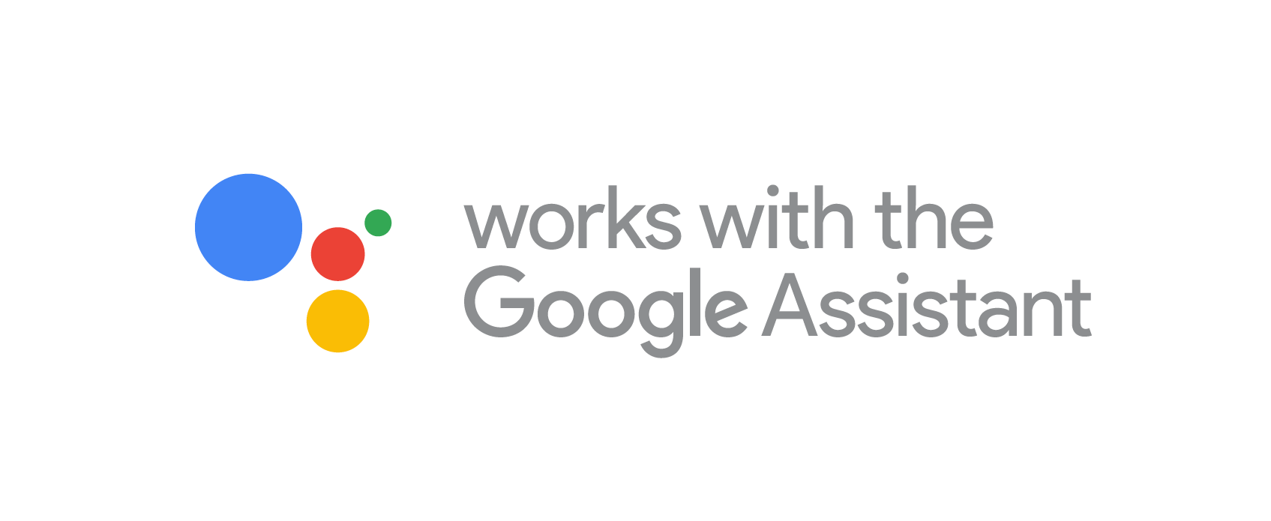
Actions on Google
Dialogflow & Actions on Google
Zubin Pratap | Manindra Arora
@ZubinPratap
Melbourne, 17 July 2019

Slide 2
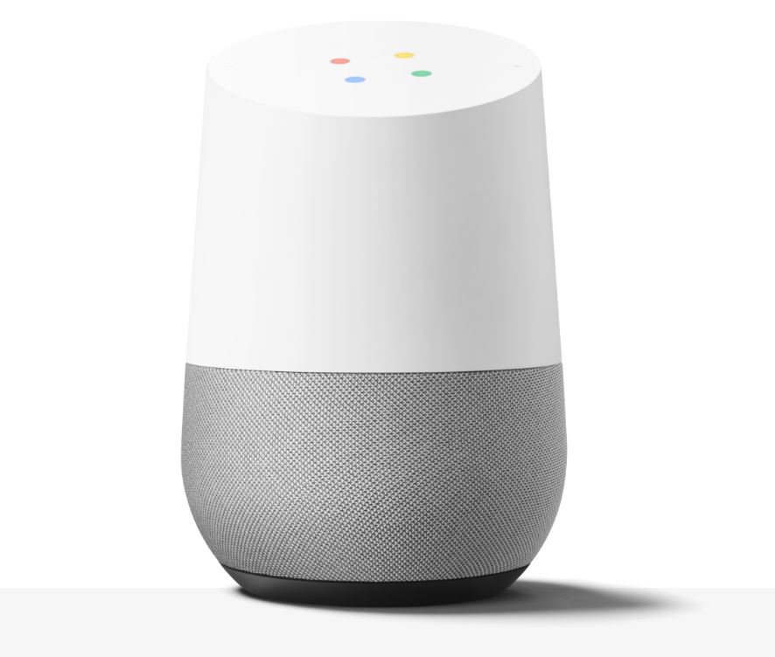
Conversational Interface for the Google Assistant
Google Assistant - Virtual Personal Assistant
> 1 Billion devices (speakers, phones, cars, speakers, headphones, TVs…)
Conversational UI and Visual U/I
“Actions on Google” : Actions that you create extend Google Assistant’s functionality

Slide 3
Three-Part Workshop
Part 1: Codelabs 1 - Terminology, Tools, Basic Concepts, simple app
Part 2: Codelabs 2 - API concepts
Part 3: Intermediate API Concepts

Slide 4
Today: Workshop 3
=> Refresher on Workshop 1 & 2 concepts
=> Replace session storage with persistent storage (store between invocations)
=> re - prompts (handle user silence)
=> gracefully exit conversations at any point
=> rich visual elements - a selection of UI for responding via devices
SDK storage objects | Firebase CLI | DialogFlow Agent | NLU follow ups
Custom re prompts | custom exits | visual interactive UI

Slide 5
Key Concepts for Voice Apps
Term | Meaning
Actions | “An Action is an entry point into an interaction that you build for the Assistant. Users can request your Action by typing or speaking to the Assistant.” A collection of Actions makes up your voice app and is equivalent to an Alexa “skill” Actions are broadly in 3 categories : conversational, smarthome/IoT and content distribution
Invocation | The “trigger” phrase that starts the voice app interaction. Equivalent to the “wake word” in Alexa
Utterance | Whatever a user says that the Action is designed to handle/respond to.
Entities (slots) | A category of thing that the NLU model is trained to identify members of (eg colours, weights, fruit) - two types : user created and “system” (platform provided) entities
Intent | NLP term to describe the purpose of a given utterance. What is the intent (purpose) behind the user’s utterance? What do they want to achieve?
Fulfillment | Every Intent needs to be “fulfilled”. Responded to. That is typically done either using DialogFlow and/ or a fulfillment webservice accessed via a HTTP endpoint.

Slide 6
Workshop 1 & 2 recap
Our first voice app:
Explicit invocation , Implicit invocation
Intent matching, including via server-based fulfilment using Firebase Functions
Custom responses, by resolving ‘entities’
Rich visual responses (Device UI), for multi modal interaction
Store data between turns of a single conversation
SSML
Skills you learned:
Using Dialogflow to create your first few intents & entities (slots), and train the Dialogflow agent to recognise them to produce values ( user says ‘blue’ which is identified by Dialogflow as a ‘color’ entity)
Nodejs webhook to fulfil conversation intents, using FIrebase Cloud Functions + Actions-on-google nodejs SDK

Slide 7
QUESTIONS?

Slide 8
Let’s get setup and code!
Codelabs:
just google “actions on google + codelabs 3”
Console:
https://console.actions.google.com/

